Slide 1












SDWAN Advantages
Private /MPLS
3G/4G LTE
SaaS / IaaS
Cloud Gateways
SD-WAN Overlay
Branch Edges
Internet Broadband
Datacenter Edges
Simplified WAN Management
Assured Application Performance
Managed on-ramp to the cloud
Zero touch deployments, simplified operations, one-click service insertion
Transport independent performance for the most demanding apps, leverages economical bandwidth
Direct cloud access with
performance, reliability and security
Notes:
VC SDWAN solution is a logical overlay network
Can encompass any WAN transport, whether private, public, even LTE
Independent of any service provide
These nodes are deployed at branches and datacenters in what we call Edges
These can be appliances or virtual software appliances running on any x86 server
This overlay is also extended to any cloud POP or datacenter with the cloud Gateways
So the first benefit is SIMPLIFYING the management of WANs
Provides the flexibility to use multiple circuit
unique benefit assure the performance of critical applications
Over any transport, including Internet
Means can fully leverage economical bandwidth for significant cost reductions
Finally, we support the migration of apps to the cloud
The VC solution provides all the same performance, simplication and security benefits to the doorstep of cloud applicacations

Slide 2
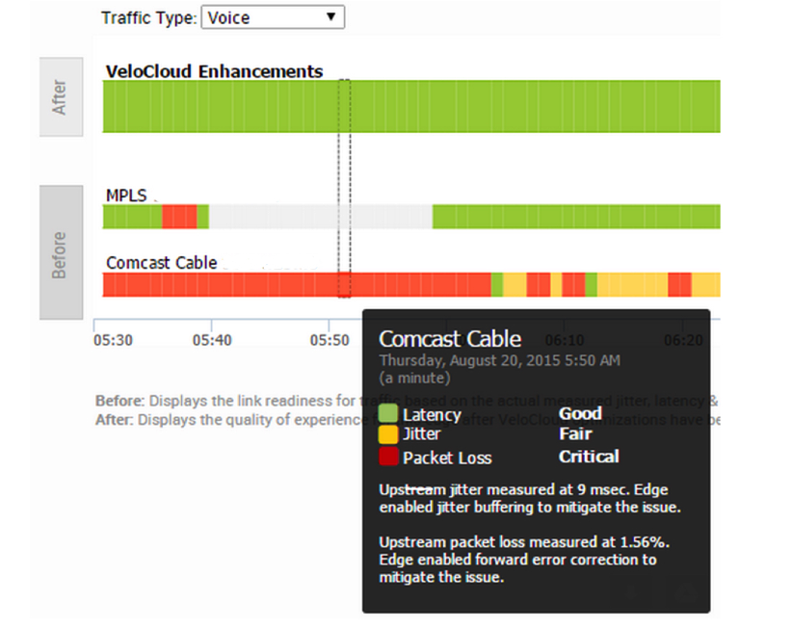
Dynamic Multi-Path Optimization
Assured Application performance over MPLS, Internet broadband and LTE circuits
Continuous Monitoring
  Automatic capacity testing
  Continuous link & path quality monitoring
Dynamic App Steering
App aware per Packet Steering
Virtualized: apps not tied to links
Aggregated bandwidth for single flows
Policies abstracted by service groups
Backup link policy
Case Study: Retail Hybrid WAN
MPLS packet loss and outage
Performance issues on CABLE
VeloCloud Delivers Excellent VoIP Quality
Sub-sec steering of VOIP without call drops
On-demand mitigation of packet loss & jitter
On Demand Remediation
Error & jitter correction
Automatic steering for brownouts/blackout
Notes:
** DMPO now assures app perf INCLUDING OVER PRIVATE
** MPLS Class of Service aware as well
--can auto monitor or define SLAs by CoS; and steering decisions will select right CoS
In addition to automatic steering, policies for preferred or mandatory circuit usage are supported
And to make universally applicable, by link group eg public – whether wired or wireless
Case study highlights the differentiation
Other hybrid or SDWAN assume SLA of private and depend on it for critical app perf
And rightly so given perf of broadband.
OTHERS WOULD FAILOVER, BUT NOT SUBSEC STEER FROM PRIVATE, NOR BE ABLE TO FIX CABLE

Slide 3








Combine All WAN Links with Intelligent Link Bonding
Activate Idle Backup Links to Increase Throughput and Application Performance
Poor WAN link utilization with active/standby
10x higher throughput, better app performance
Enterprise
Backup
Enterprise
Backup
Traditional WAN
Borderless Cloud-Delivered SD-WAN
Typical setup is active/standby WAN. Complex routing protocol tuning required to enable active/active.
Link performance degradation will severely affect throughput
Per-packet load balancing utilizes all links to maximize throughput even for single traffic flow, e.g. large backup
Real time link performance awareness on-demand remediation ensures maximum possible throughput

Slide 4
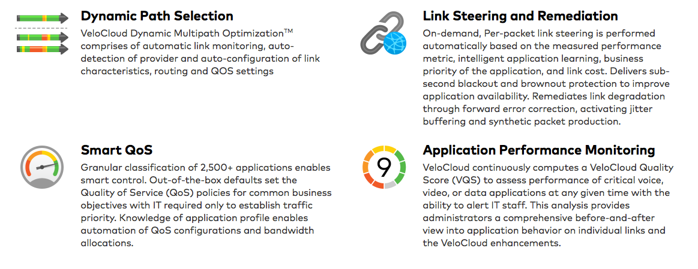
Performance Management

Slide 5
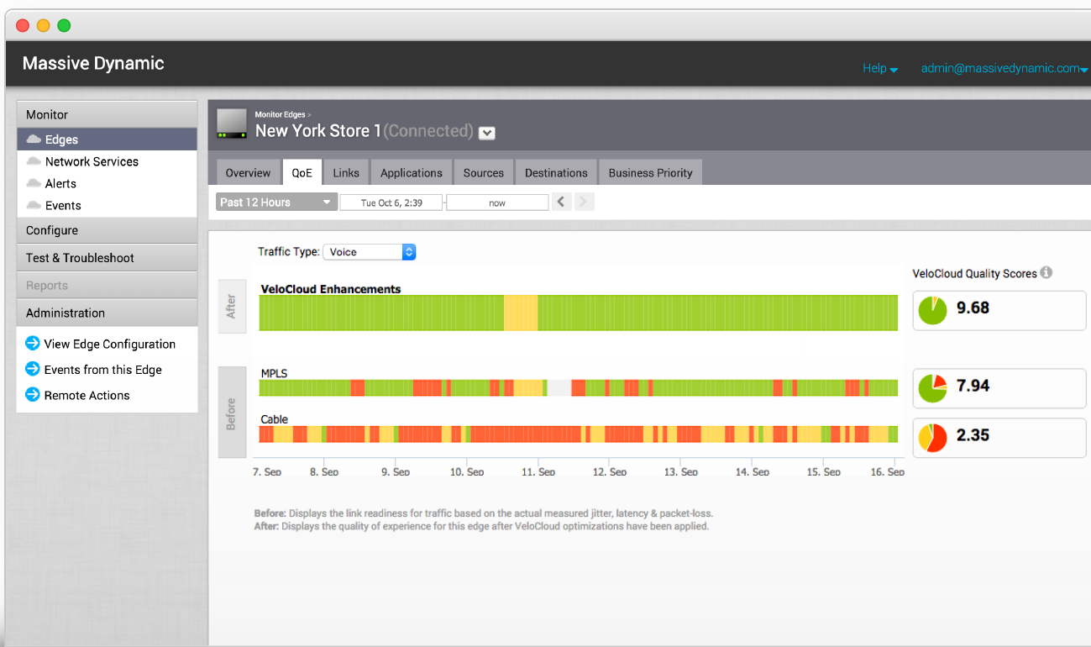
Performance Over Dual Circuits
WAN Monitoring:
  Automatic capacity testing
  Continuous link & path quality monitoring
  Provides greater uptime and bandwidth
Dynamic Multipath Optimization:
  Aggregate Links
  Application Steering – App aware, sub-second, packet per packet steering
  Optimal link &path across Internet and private (no dropped calls on outages)
Link Remediation:
  Error & jitter correction
  Automated failover & steering for brownouts/blackouts
  High quality voice and business critical app performance

Slide 6
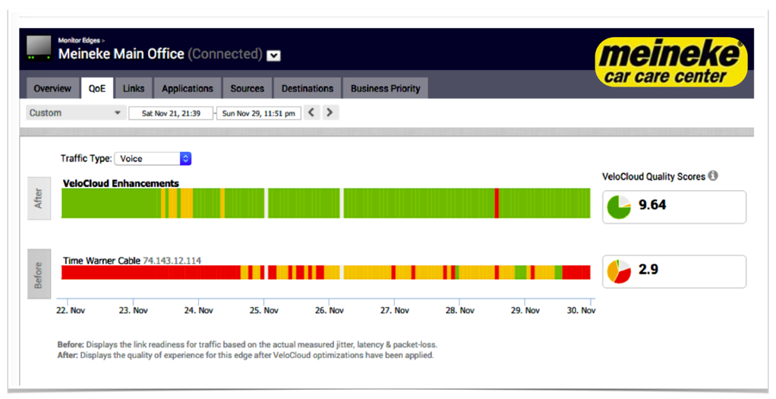
Performance Over Single Circuit
Link Remediation and Correction
  Improve voice / circuit quality over broadband and struggling circuits

Slide 7




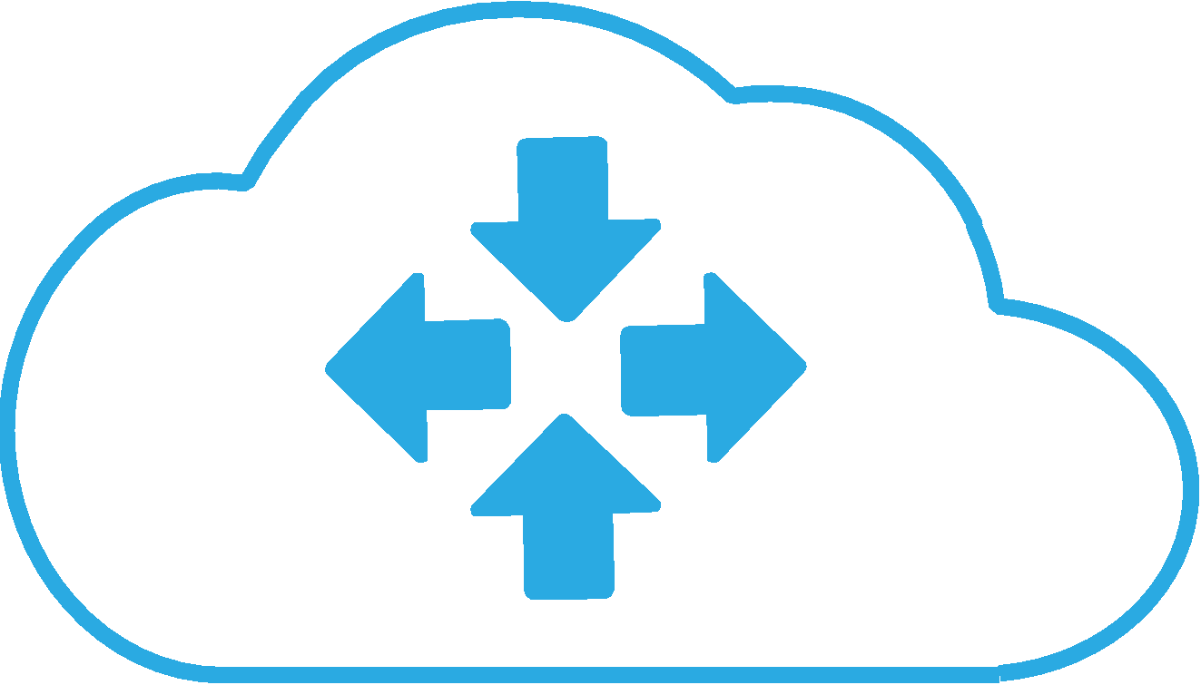





Topology
Simple Provisioning
Service Insertion
Zero-Touch
Direct to Cloud
Zero-Touch
VeloCloud
Orchestrator
Cloud
& SaaS
Broadband Internet – DSL, Cable, Fiber
Broadband Internet – DSL, Cable, Fiber
Private – MPLS - Ethernet
Private – MPLS - Ethernet
4G - LTE
4G - LTE
VeloCloud
Edge
Branch
Software-defined WAN
IP SEC
Datacenter
Maximized Bandwidth
Expand Your WAN
Pay-as-You-Go
Non-VeloCloud
Datacenter
Notes:
Simple Provisioning, Policy, & Visibility via Cloud Orchestration
Zero touch, Thin branch, Auto Provisioned from Cloud
Maximize Combined Bandwidth, Performance & Monitoring
Expand (not replace) the WAN to Enable New Apps
Scalable, Pay-as-You-Go Cloud Network, Low TCO
Direct Path to Hybrid Cloud, SaaS and Enterprise DC
Cloud Service Insertion (Service Chaining)

